Slide 1
Office 365 List Formatting
And 2019 too!
(sorta)
Chris Kent
Office 365 Practice Lead, DMI

Slide 3















“Me”
Indianapolis, IN
Office Development
Office 365 Practice Lead
@theChrisKent
Member of the Core Team
theChrisKent.com
Notes:
Can I possibly get my name on a single slide even more? Wow.

Slide 4
Goals

Slide 5
Column Formatting
What | Why | How

Slide 6
View
Formatting
What | Why | How

Slide 7
Resources
Samples | Guidance | Tools

Slide 9

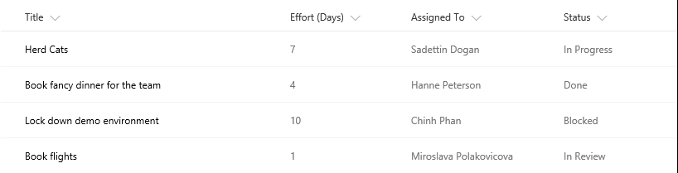
The Modern Listview
Responsive
Fancy
Boring
No XSLT
No Calculated Column Trickery

Slide 10


Dapper
The Modern Listview

Slide 11

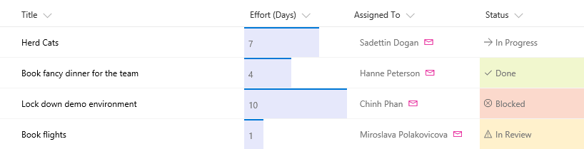

Slide 12


List Formatting
Declarative modern listview customization

Slide 13
List Formatting
Pretty Lists
Column Formatting
View Formatting

Slide 14
List formatting allows you to quickly and easily add instant meaning, visual appeal, and dynamic visualizations directly to your lists.

Slide 15
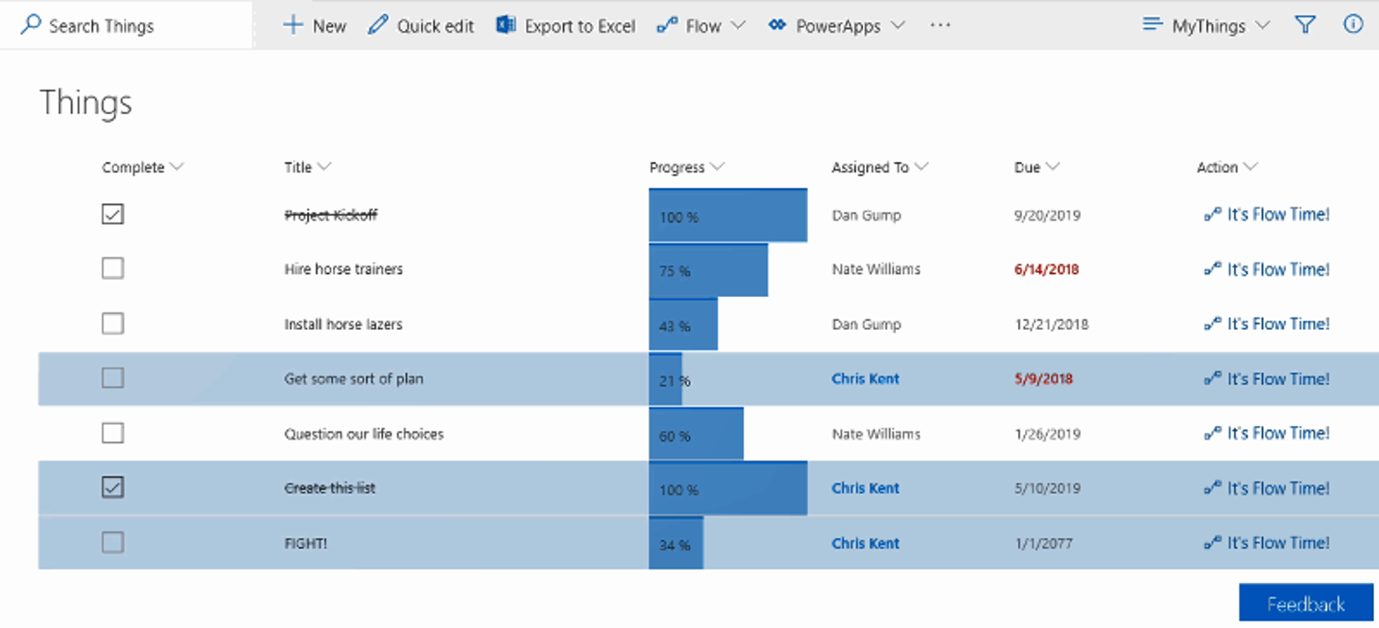

List formatting allows you to quickly and easily add instant meaning, visual appeal, and dynamic visualizations directly to your lists.
List formatting allows you to quickly and easily add instant meaning, visual appeal, and dynamic visualizations directly to your lists.
Missed Due Dates in Red
Checkboxes
vs
Yes/No

Slide 16

List formatting allows you to quickly and easily add instant meaning, visual appeal, and dynamic visualizations directly to your lists.

Slide 17
List formatting allows you to quickly and easily add instant meaning, visual appeal, and dynamic visualizations directly to your lists.
Dynamic Progress Bars
Items Assigned To the Current User

Slide 18
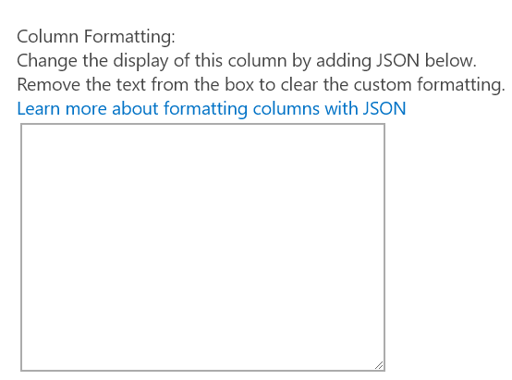
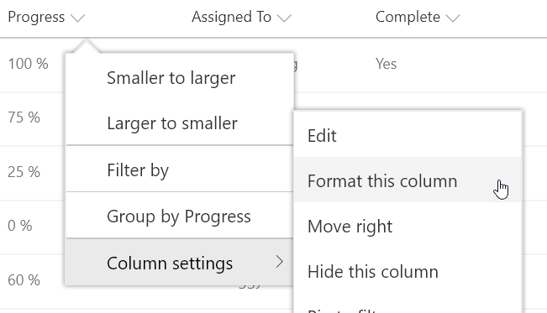
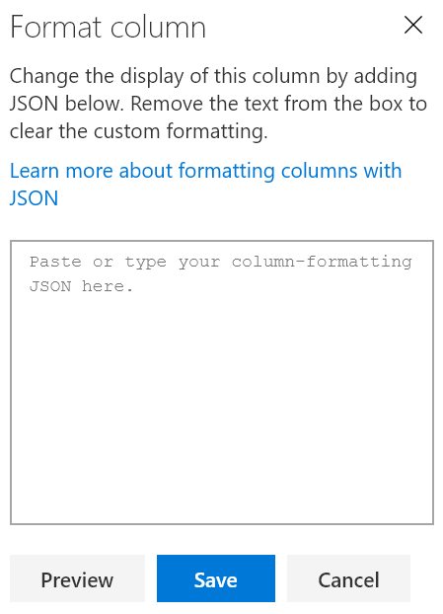

Column Formatting
JavaScript Object Notation (JSON)
Apply directly to list fields or site columns
Field Settings
Format this column menu
Stored with the Field
Paste Here
O365 & 2019

Slide 19
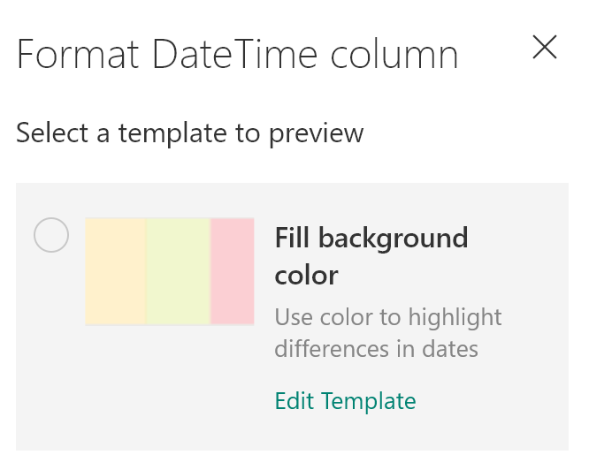
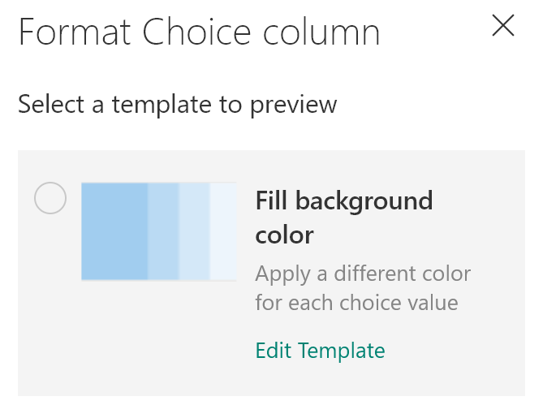
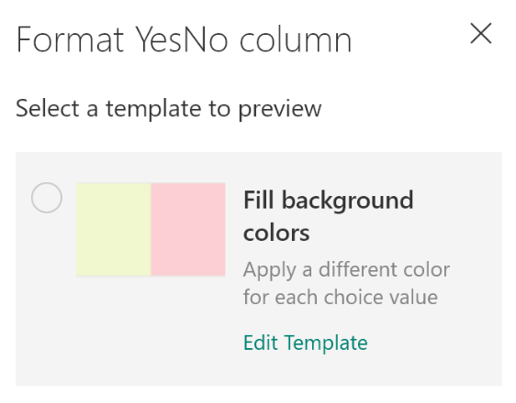
Calculated Date Columns Too
Calculated Yes/No Columns Too
Column Formatting Design Mode

Slide 20
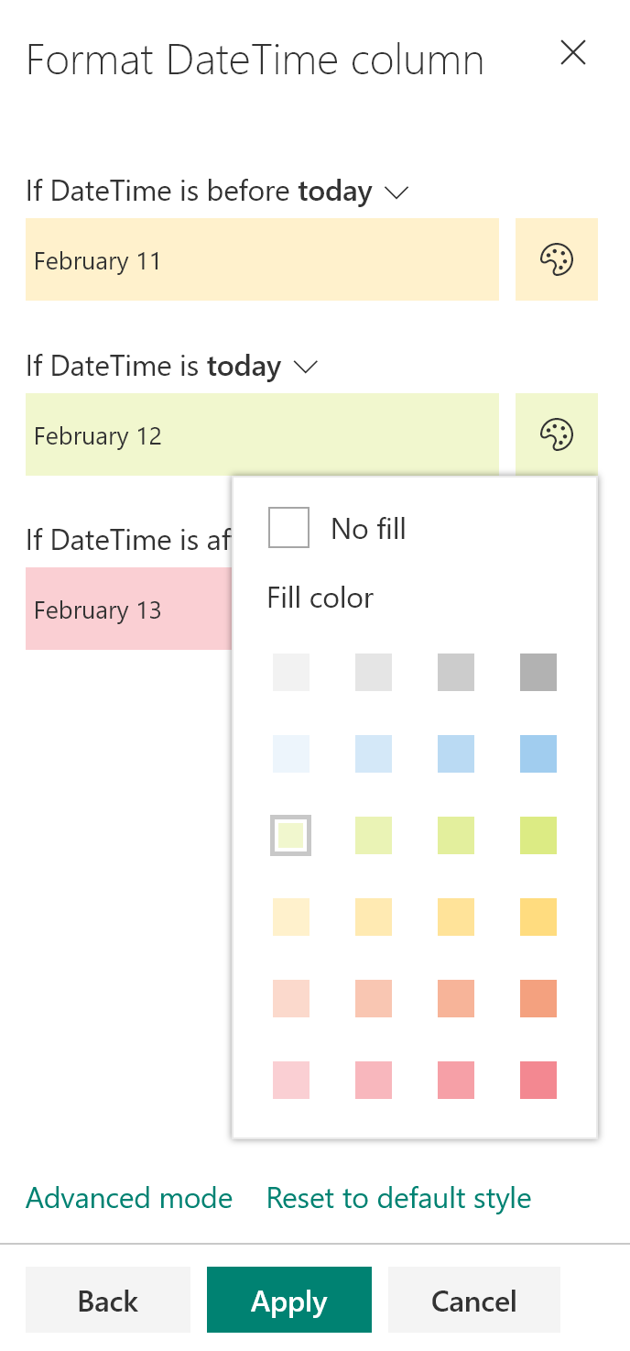
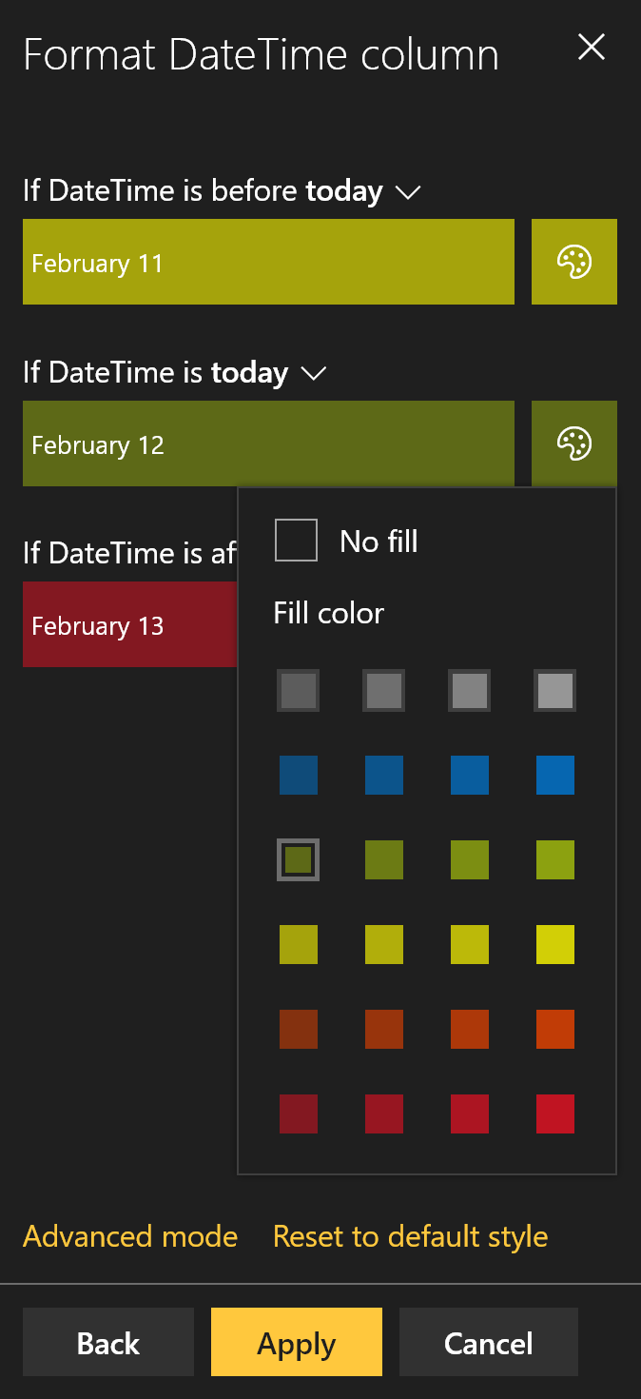
Pre-selected Color Classes
Adjusts for Dark Themes
Switch to JSON
Column Formatting Design Mode

Slide 21
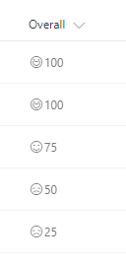
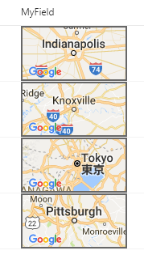
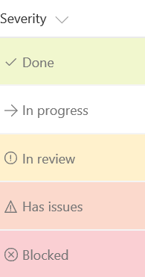
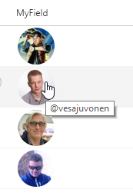
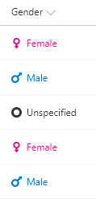
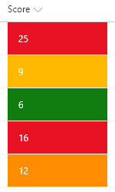

SP-Dev-List-Formatting Samples
40+ Sample Formats
Instructions & Screenshots
Copy & Paste directly from Github
github.com/SharePoint/SP-Dev-List-Formatting

Slide 22

Demo: Column Formatting

Slide 23
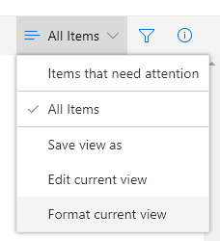
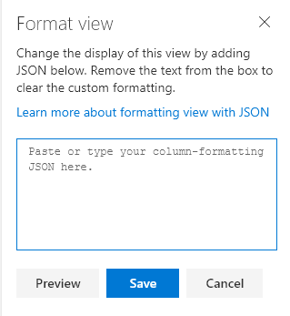

View Formatting
Superset of Column Formatting
Apply directly to views
Format current view menu
Stored with the View
Overrides Column Formats (Row Formats)
Paste Here
O365 & 2019

Slide 24



View Formatting Flavors
Row Class
Row Format
Uses additionalRowClass
Applies class(es) to each row
Can be conditionally applied
Ignored when rowFormatter is used
Uses rowFormatter
Responsible for full rendering of the row

Slide 25
Demo: View Formatting

Slide 26



Supported Column Types
Calculated
Choice
ContentType
Counter (ID)
Currency*
Date/Time
Hyperlink
Lookup
Multi-Choice
Multi-Line Text*
Multi-Person
Number
Person
Picture
Single line of text
Title (in Lists)
Yes/No
Can’t Reference:
Managed Metadata
Retention Label
Filename (in Document Libraries)
https://github.com/SharePoint/sp-dev-docs/issues/1524
Same support applies to both Column and View Formatting
*Apply Format through Field Settings

Slide 27


Don’t Use Rich Text
List Formatting encodes values
Rich text values contain HTML
HTML will be encoded and displayed

Slide 28
JSON Syntax Crash Course
{
“elmType”: “div”,
“debugMode”: false
}
An object is a set of name/value pairs
Objects begin with a { and end with a }
Each name is followed by a :
Name/value pairs are separated by a ,
Adapted from json.org

Slide 29
JSON Syntax Crash Course
{
“elmType”: “div”,
“debugMode”: false,
“children”: [
{
“elmType”: “span”,
“txtContent”: “Yo”
},
{
“elmType”: “span”,
“txtContent”: “ Dawg!”
}
]
}
An object is a set of name/value pairs
Objects begin with a { and end with a }
Each name is followed by a :
Name/value pairs are separated by a ,
An array is an ordered collection of values
Arrays begin with a [ and end with a ]
Array values are separated by a ,
Adapted from json.org

Slide 30
JSON Syntax Crash Course
{
“elmType”: “div”,
“debugMode”: false,
“children”: [
{
“elmType”: “span”,
“txtContent”: “Yo”
},
{
“elmType”: “span”,
“txtContent”: “ Dawg!”
}
],
“style”: {
“color”: “red”,
“padding-left”: “4px”
}
}
An object is a set of name/value pairs
Objects begin with a { and end with a }
Each name is followed by a :
Name/value pairs are separated by a ,
An array is an ordered collection of values
Arrays begin with a [ and end with a ]
Array values are separated by a ,
A value can be a string in double quotes, a number, true, false, null, object, or array
Adapted from json.org

Slide 31
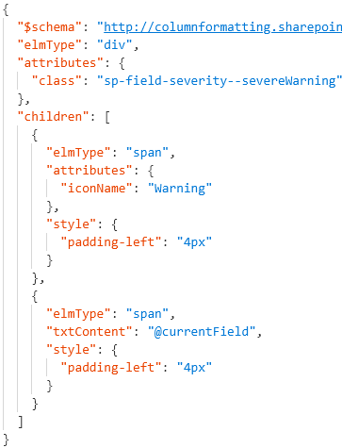

Format JSON
Rendered Column
Element Visualization
div
span
span
Generated HTML
<div class="sp-field-customFormatter sp-field-severity--severeWarning">
<span style="padding-left:4px;" iconname="Warning" class=" css-148"></span>
<span style="padding-left:4px;">Wise Polar Bear</span>
</div>

Slide 32
View Formatting Syntax
Top level props
hideColumnHeader
When true, the view won’t have any column headers
hideSelection
When true, users can’t select rows
additionalRowClass
Class(es) to apply to the whole row
You can use operation syntax
Only applied when rowFormatter is not specified
rowFormatter
Column Formatting syntax to create elements

Slide 33

“elmType”: “”
Only Required Property
div (box)
span (inline box)
a (link)
img (picture)
button (clicky thing)
svg (fancy picture)
path (part of the fancy picture)

Slide 34

Element Content
What’s in the Box
txtContent
Text value
OR
children
Sub elements
Ignored when txtContent is specified

Slide 35

“attributes”: { }
Directly in the element
Everybody
class – CSS class(es)
title - tooltip
iconName – UIFabric icon
role - accessibility
aria-* -accessibility
a (links)
href – where to go
target – open in new window or not
rel – relationship
img
src – image location
path
d – path to be drawn

Slide 36

“style”: { }
Nest in the style attribute
132
background-color
fill
background-image
border
border-bottom
border-bottom-color
border-bottom-style
border-bottom-width
border-color
border-left
border-left-color
border-left-style
border-left-width
border-right
border-right-color
border-right-style
border-right-width
border-style
border-top
border-top-color
border-top-style
border-top-width
border-width
outline
outline-color
outline-style
outline-width
border-bottom-left-radius
border-bottom-right-radius
border-radius
border-top-left-radius
border-top-right-radius
box-decoration-break
box-shadow
box-sizing
overflow-x
overflow-y
overflow-style
rotation
rotation-point
opacity
cursor
height
max-height
max-width
min-height
min-width
width
flex-grow
flex-shrink
flex-flow
flex-direction
flex-wrap
flex
justify-content
align-items
box-align
box-direction
box-flex
box-flex-group
box-lines
box-ordinal-group
box-orient
box-pack
font
font-family
font-size
font-style
font-variant
font-weight
font-size-adjust
font-stretch
grid-columns
grid-rows
margin
margin-bottom
margin-left
margin-right
margin-top
column-count
column-fill
column-gap
column-rule
column-rule-color
column-rule-style
column-rule-width
column-span
column-width
columns
padding
padding-bottom
padding-left
padding-right
padding-top
bottom
clear
clip
display
float
left
overflow
position
right
top
visibility
z-index
border-collapse
border-spacing
caption-side
empty-cells
table-layout
color
direction
letter-spacing
line-height
text-align
text-decoration
text-indent
text-transform
unicode-bidi
vertical-align
white-space
word-spacing
hanging-punctuation
punctuation-trim
text-align-last
text-justify
text-outline
text-shadow
text-wrap
word-break
word-wrap

Slide 37

“customRowAction”: { “action”: “”}
defaultClick – opens the info pane
share – opens the sharing dialog
delete – opens the delete confirmation dialog
editProps – opens the info pane in edit mode
executeFlow – launches the specified Flow
Flow must be associated with the list items
ID is specified using the actionParams property

Slide 38
Demo: customRowAction
Notes:
Demonstrate Contact Card Row Format View Formatting Sample: https://github.com/SharePoint/sp-dev-list-formatting/tree/master/view-samples/contact-card-format
Demonstrate Generic Start Flow Column Formatting Sample: https://github.com/SharePoint/sp-dev-list-formatting/tree/master/column-samples/generic-start-flow
Additional Details here: https://thechriskent.com/2018/08/29/list-formatting-quick-tip-format-only-columns/

Slide 39
Predefined Classes
sp-field-severity--good |  | background-color
sp-field-severity--low |  | background-color
sp-field-severity--warning |  | background-color
sp-field-severity--severeWarning |  | background-color
sp-field-severity--blocked |  | background-color
sp-field-dataBars |  | background-color, padding, color, border-top
sp-field-trending--up | text | color
sp-field-trending--down | text | color
sp-field-quickActions |  | font, padding (used with icons)
Use UIFabric.io color & typography classes to match theme

Slide 40
Design Mode Classes
sp-css-backgroundColor-
neutralBackground (50,40,30)
blueBackground07 (17,27,37)
successBackground (50,40,30)
warningBackground (50,40,30)
blockingBackground (50,40,30)
errorBackground (50,40,30)

Slide 41
Demo: UIFabric classes &
icons

Slide 42
Magic Text
…
“txtContent”: “@currentField”
…
“@currentField”
Get the current item’s value
Works great for simple values (text, choice, yes/no, and numbers)
Type is respected
Dates should use one of the format operations:
“toLocaleString()” – date and time
“toLocaleDateString()” – just the date
“toLocaleTimeString()” – just the time
Always resolves to Title in view formatting

Slide 43
Magic Text
…
“txtContent”: “@currentField.title”
…
“@currentField”
Get the current item’s value
Person field props
Can’t use “@currentField” directly, use dot-notation to get properties:
“@currentField.title”
“@currentField.id”
“@currentField.email”
“@currentField.sip”
“@currentField.picture”

Slide 44
Magic Text
…
“txtContent”:
“@currentField.lookupValue”
…
“@currentField”
Get the current item’s value
Person field props
Can’t use @currentField directly, use dot-notation to get properties:
“@currentField.lookupValue”
“@currentField.lookupId”
Lookup field props

Slide 45
Magic Text
…
“txtContent”:
“@currentField.desc”
…
“@currentField”
Get the current item’s value
Person field props
Can use @currentField directly AND dot-notation to get properties:
“@currentField” – URL value
“@currentField.desc” - Description
Lookup field props
Hyperlink field props

Slide 46
Magic Text
…
“txtContent”: “[$Title]”
…
“@currentField”
Get the current item’s value
Person field props
Wrap internal name in [$FIELD]
Access Person/Lookup/URL properties in same way as with @currentField
“[$Author.email]”
“[$OtherListItem.lookupValue]”
Lookup field props
Hyperlink field props
Other Fields (same row)

Slide 47
Magic Text
…
“txtContent”: “@me”
…
“@currentField”
Get the current item’s value
Person field props
“@me” resolves to the current user’s email address
“@now” resolves to the date/time at render (doesn’t keep getting evaluated)
Lookup field props
Hyperlink field props
Other Fields (same row)
“@me”
“@now”

Slide 48
Magic Text
…
“txtContent”:
“@window.innerHeight”
…
“@currentField”
Get the current item’s value
Person field props
“@window.innerHeight” resolves to a number equal to the height of the browser window (in pixels) at render
“@window.innerWidth” resolves to a number equal to the width of the browser window (in pixels) at render
Lookup field props
Hyperlink field props
Other Fields (same row)
“@me”
“@now”
These do NOT update as the window resizes
“@window”

Slide 49

Referencing Local Resources in Formats
Hardcoded URL
Always works
Not reusable across sites
Relative URL
Reusable across sites
URLs dependent on relative location, fragile

Slide 50

@currentWeb
Same as Page Context webAbsoluteUrl
Does not end with a slash

Slide 51


Expressions
Abstract Syntax Tree (AST)
operator/operands
Nest additional expressions
Excel-style expressions
Single line
Combine expressions
O365 Only
Electrolytes
It’s got what plants crave!

Slide 52
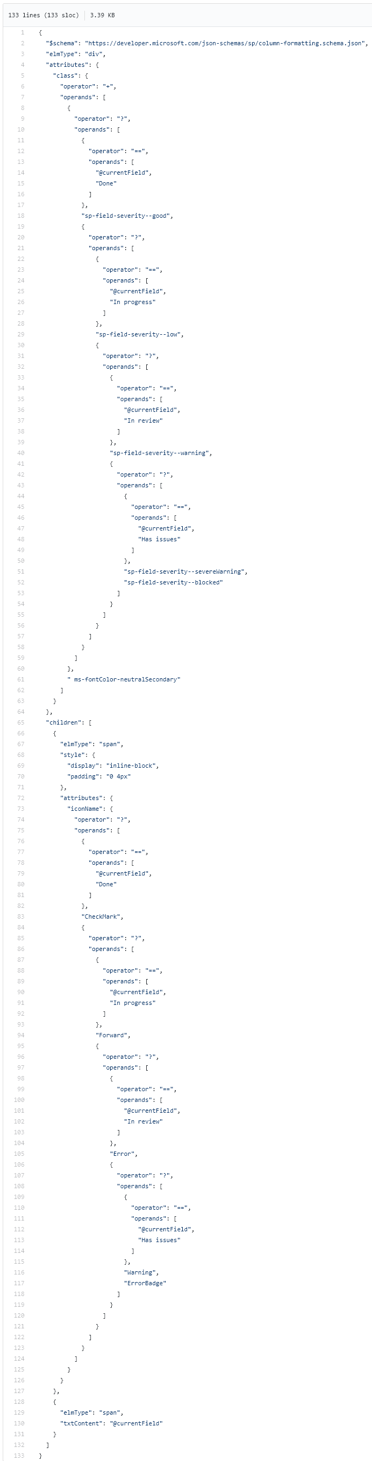
Expressions
Abstract Syntax Tree (AST)
operator/operands
Nest additional expressions
Excel-style expressions
Single line
Combine expressions
Electrolytes
It’s got what plants crave!

Slide 53
Expressions
Abstract Syntax Tree (AST)
operator/operands
Nest additional expressions
Excel-style expressions
Single line
Combine expressions
Electrolytes
It’s got what plants crave!

Slide 54
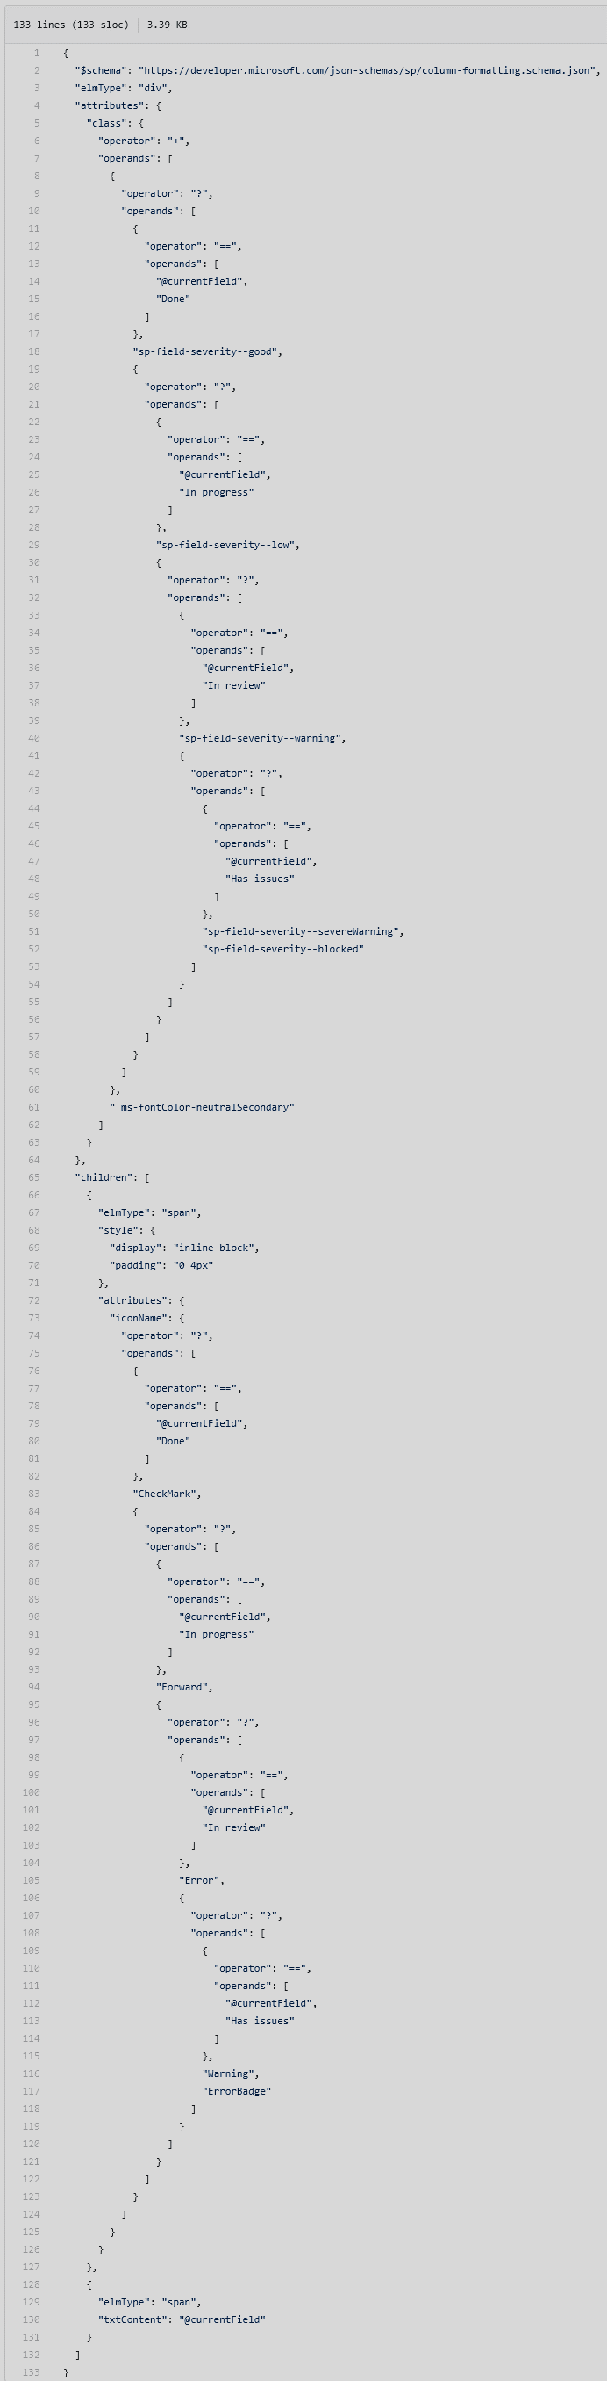
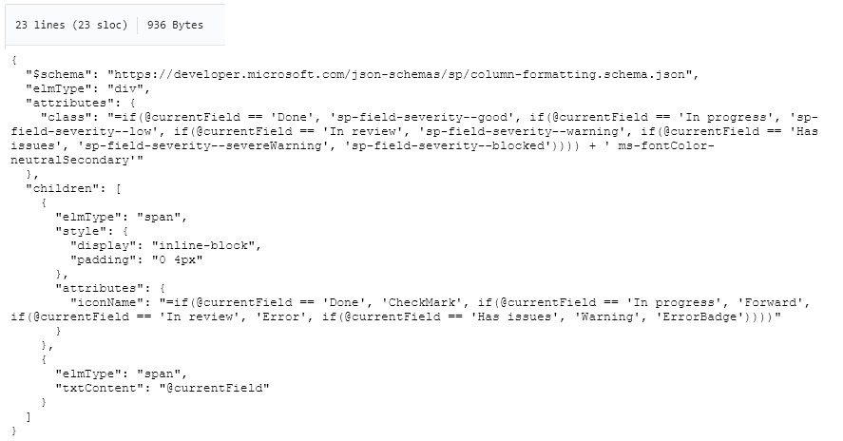
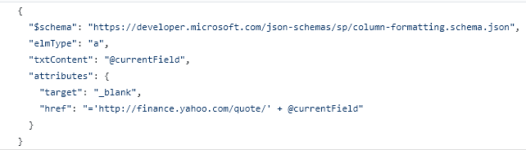
Expressions
Abstract Syntax Tree (AST)
operator/operands
Nest additional expressions
Excel-style expressions
Single line
Combine expressions
Electrolytes
It’s got what plants crave!

Slide 55


Arithmetic Operators
+ Addition
- Subtraction
/ Division
* Multiplication
cos Cosine
sin Sine

Slide 56

Conditional & Logical Operators
< Less Than
> Greater Than
<= Less Than or Equal
>= Greater Than or Equal
== Equals
!= Not Equals
|| Or
&& And
? If

Slide 57

Conversion Operators
toString() Converts to text
Number() Converts to Number
Date() Converts to DateTime
toLowerCase Converts text to lowercase
toLocaleString() Converts DateTime to locale text
toLocaleDateString() Converts DateTime to locale date only text
toLocaleTimeString() Converts DateTime to locale time only text

Slide 58

Other Operators
join
Turns arrays into strings with a separator
length
Length on an array, NOT a string
indexOf
Character index (starting at 0) of some text within text

Slide 59
Column Formatting vs Field Customizer
Customization | Column Formatting | Field Customizer
Conditional Formatting based on item values | Supported | Supported

Slide 60
Column Formatting vs Field Customizer
Customization | Column Formatting | Field Customizer
Conditional Formatting based on item values | Supported | Supported
Action Links | Static links (no script) | Any type of link

Slide 61
Column Formatting vs Field Customizer
Customization | Column Formatting | Field Customizer
Conditional Formatting based on item values | Supported | Supported
Action Links | Static links (no script) | Any type of link
Visualizations | Simple Visualizations (HTML & Styles) | Whatever!

Slide 62
Column Formatting vs Field Customizer
Customization | Column Formatting | Field Customizer
Conditional Formatting based on item values | Supported | Supported
Action Links | Static links (no script) | Any type of link
Visualizations | Simple Visualizations (HTML & Styles) | Whatever!
Page Context | @now, @me, window size | Full context!

Slide 63
Column Formatting vs Field Customizer
Customization | Column Formatting | Field Customizer
Conditional Formatting based on item values | Supported | Supported
Action Links | Static links (no script) | Any type of link
Visualizations | Simple Visualizations (HTML & Styles) | Whatever!
Page Context | @now, @me, window size | Full context!
JS Libraries | Nope | Go for it!
Custom CSS Classes | Nope, limited subset & inline styles | Go for it!
Interactivity | Nope | Go for it!

Slide 64

Column Formatting vs Field Customizer
Customization | Column Formatting | Field Customizer
Conditional Formatting based on item values | Supported | Supported
Action Links | Static links (no script) | Any type of link
Visualizations | Simple Visualizations (HTML & Styles) | Whatever!
Page Context | @now, @me, window size | Full context!
JS Libraries | Nope | Go for it!
Custom CSS Classes | Nope, limited subset & inline styles | Go for it!
Interactivity | Nope | Go for it!
Developer Required | “No” | Yes
Solution Deployment | Nope! | Required
Use Column Formatting when possible, but know it’s limits

Slide 65

List Formatting Limitations
No Real String Operations
No Custom Date Formats or Date Parts
No viewbox attribute for SVG elements
Unable to use parenthesis in style props (except for rgba)
No Gradients
No image backgrounds
Numbers are floats and you can’t round them
Unable to determine Row Index
List Web Part Inconsistencies & Limits
OOTB User Interface is terrible

Slide 66

List Formatting Awesomeness
Quick & “easy” visualizations that can have a significant impact
Site Column integration provides centralized configuration
Text based config (easy source control)
NO Solution Package deployment required
Can be applied by Site Designers
Supported in Site Designs
PnP List Formatter fills the UI gap

Slide 67
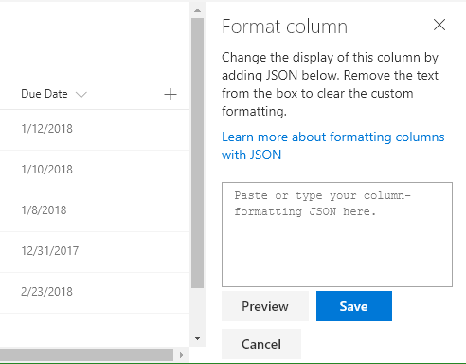
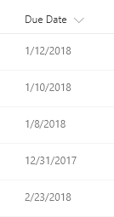

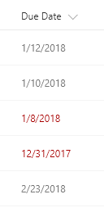



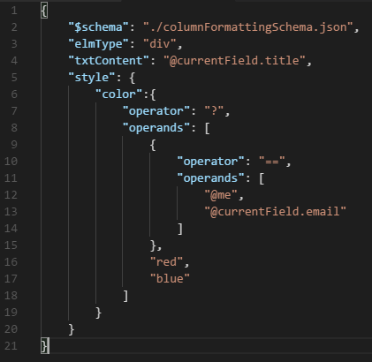

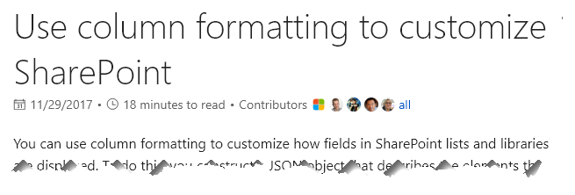




Slide 68



List Formatter Easy editor for modern listview Formatting
github.com/SharePoint/SP-Dev-Solutions

Slide 69
Final Tips & Tricks
Dapper
The Modern Listview
UI Fabric Classes
Theme Colors
Hover Styles
Grid System
Turn debugMode off
Write HTML 1st
Dynamic Images
1000+ icons – use them!
Use List Formatter

Slide 70

aka.ms/sppnp

Slide 71


Slide 72


Bi-Weekly
SP General Development
aka.ms/sppnp-core-sig-call
List Formatting, PowerApps, CSOM, PowerShell, Provisioning, Flow
Next Call: Thursday, 2/21
Bi-Weekly
SharePoint Framework
aka.ms/sppnp-js-sig-call
SPFx, PnP JS Core
Next Call: Thursday, 2/14
Monthly
Community Calls
aka.ms/sppnp-call
Monthly Summary
Next Call: Tuesday, 3/12

Slide 73



Official Blog
dev.office.com/blogs
Twitter
@OfficeDevPnP
Tech Community
aka.ms/sppnp-community

Slide 74
Final Tips & Tricks
Dapper
The Modern Listview
UI Fabric Classes
Theme Colors
Hover Styles
Font Sizes & Weights
Purge AST from your brain
Turn debugMode off
Write HTML 1st
Dynamic Images
1000+ icons – use them!
Test in multiple themes
Use List Formatter

Slide 75
Basic JSON Format (Totally NOT custom code)
Elements – elmType
div, span, a, img, svg, path, button
Content - txtContent
Attributes - attributes
class, href, src, rel, target, title, role, d, aria, iconName
Style – style (124 properties)
Children – children
Operators & Operands
basic math, comparison, conversion, logical

